Slide 1
Introduction to Linear Algebra

Slide 2
Outline
1. Matrix arithmetic
2. Matrix properties
3. Eigenvectors & eigenvalues
-BREAK-
4. Examples (on blackboard)
5. Recap, additional matrix properties, SVD

Slide 3
What is linear algebra?
• Linear algebra is the branch of mathematics
concerning linear equations such as
a1x1+…..+anxn=b
– In vector notation we say aTx=b
– Called a linear transformation of x
• Linear algebra is fundamental to geometry, for
defining objects such as lines, planes, rotations
Linear equation a1x1+…..+anxn=b
defines a plane in (x1,..,xn) space
Straight lines define common solutions
to equations

Slide 4
Why do we need to know it?
• Linear Algebra is used throughout engineering
– Because it is based on continuous math rather than
discrete math
• Computer scientists have little experience with it
• Essential for understanding ML algorithms
– E.g., We convert input vectors (x1,..,xn) into outputs
by a series of linear transformations
• Here we discuss:
– Concepts of linear algebra needed for ML
– Omit other aspects of linear algebra

Slide 5
Linear Algebra Topics
– Scalars, Vectors, Matrices and Tensors
– Multiplying Matrices and Vectors
– Identity and Inverse Matrices
– Linear Dependence and Span
– Norms
– Special kinds of matrices and vectors
– Eigen decomposition
– Singular value decomposition
– The determinant

Slide 6
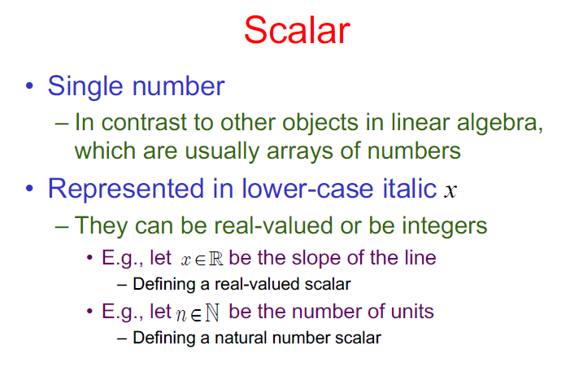

Slide 7
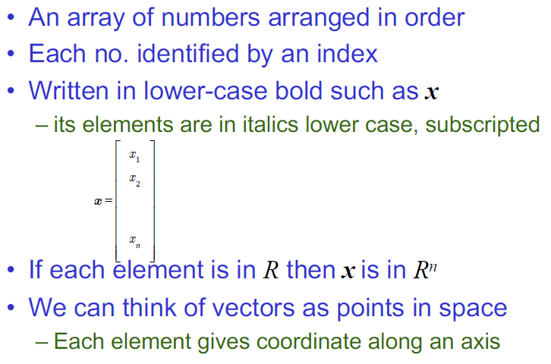
Vectors

Slide 9
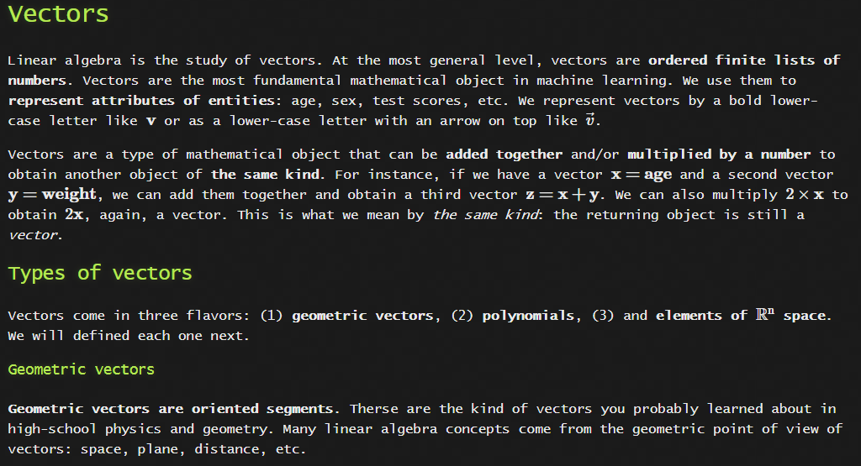

Slide 10
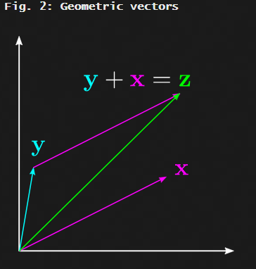

Slide 11
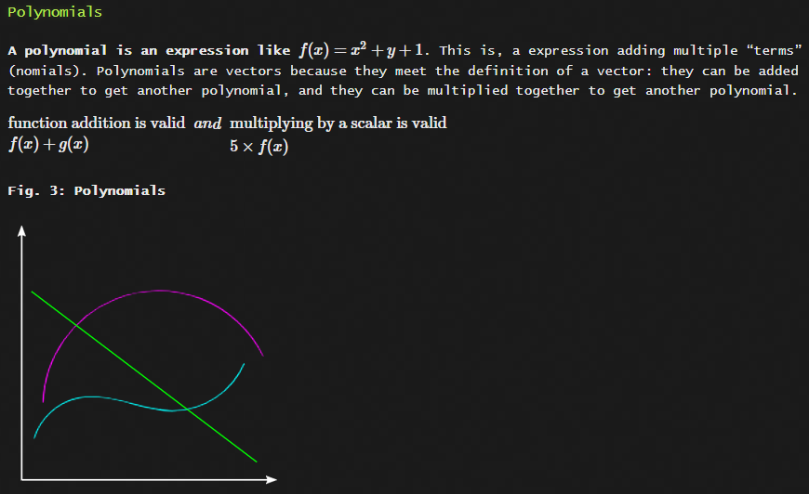

Slide 12
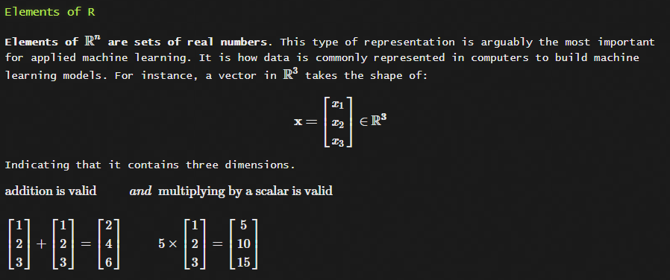

Slide 13
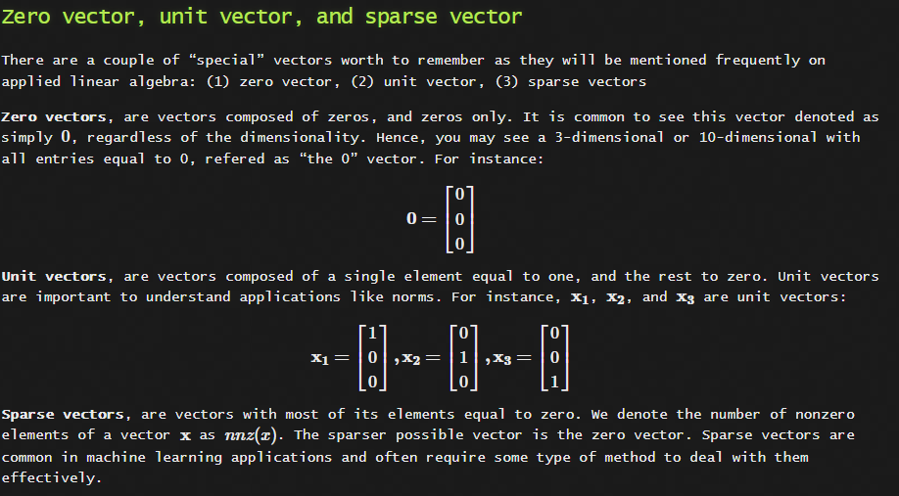

Slide 14
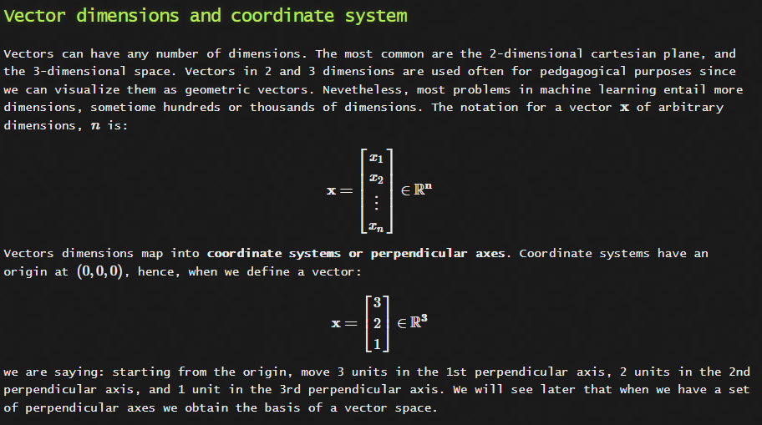

Slide 15
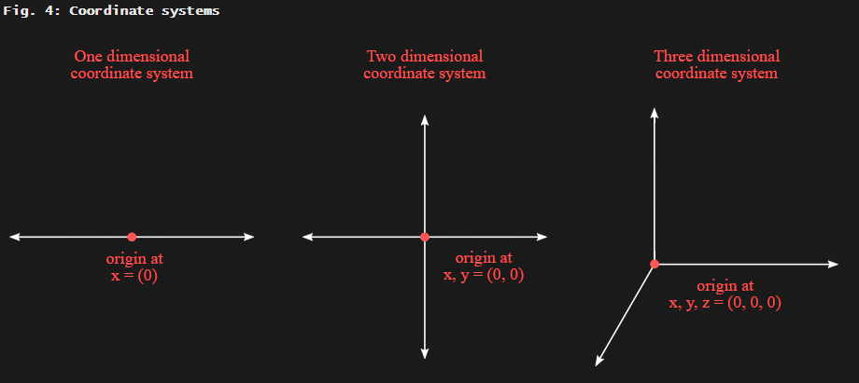

Slide 16
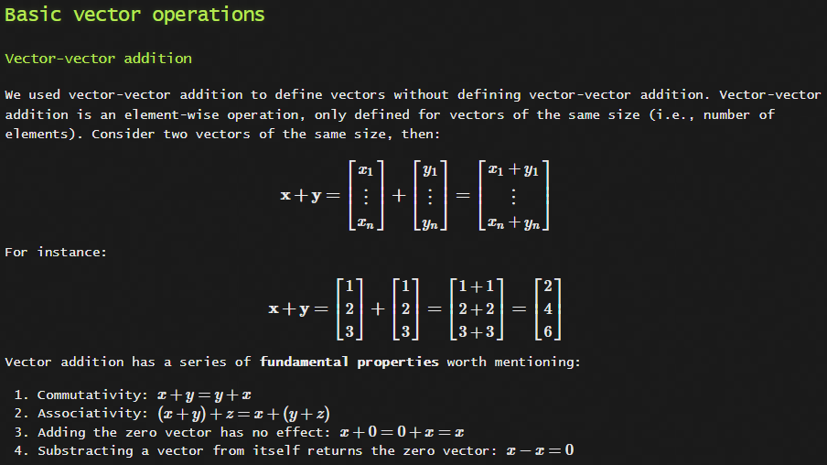

Slide 17
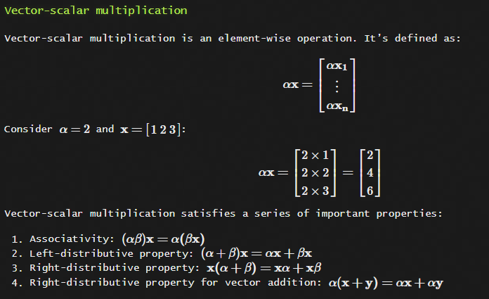

Slide 18
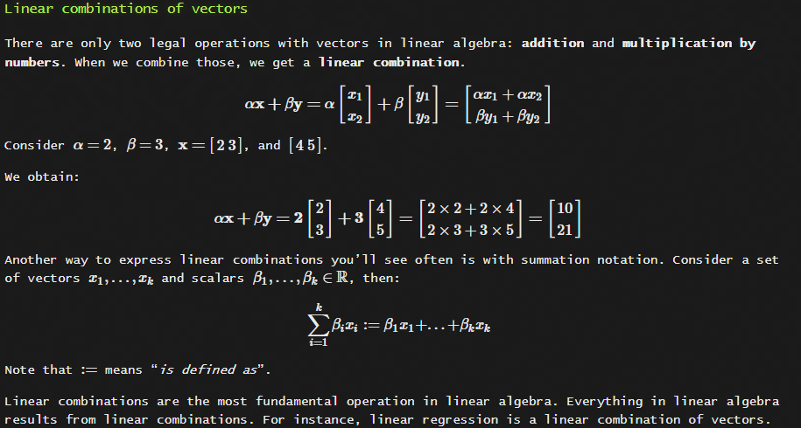

Slide 19
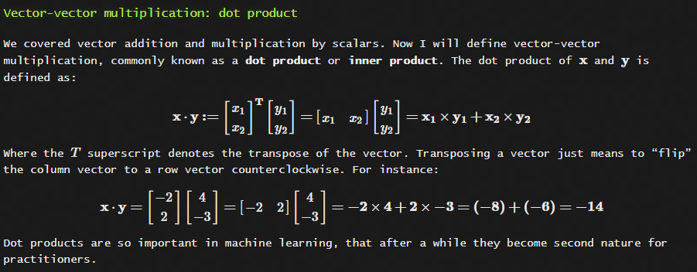

Slide 20
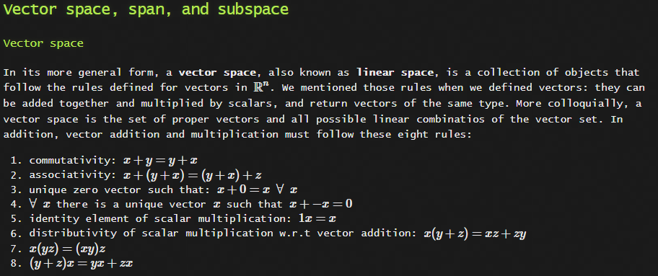

Slide 21
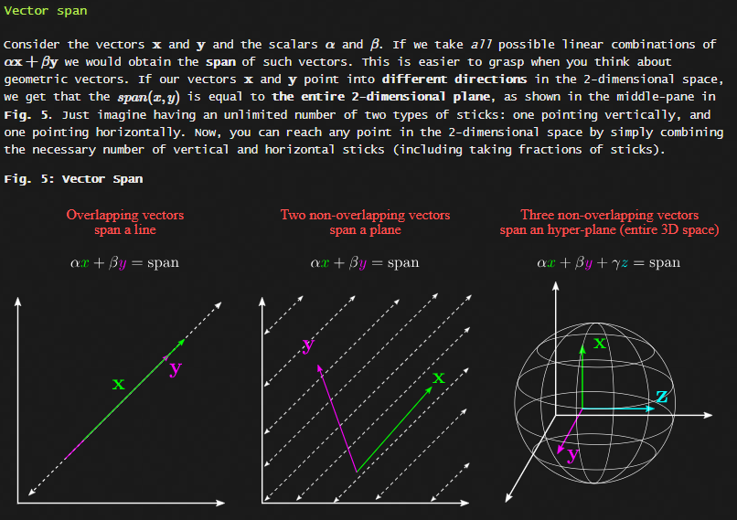

Slide 22
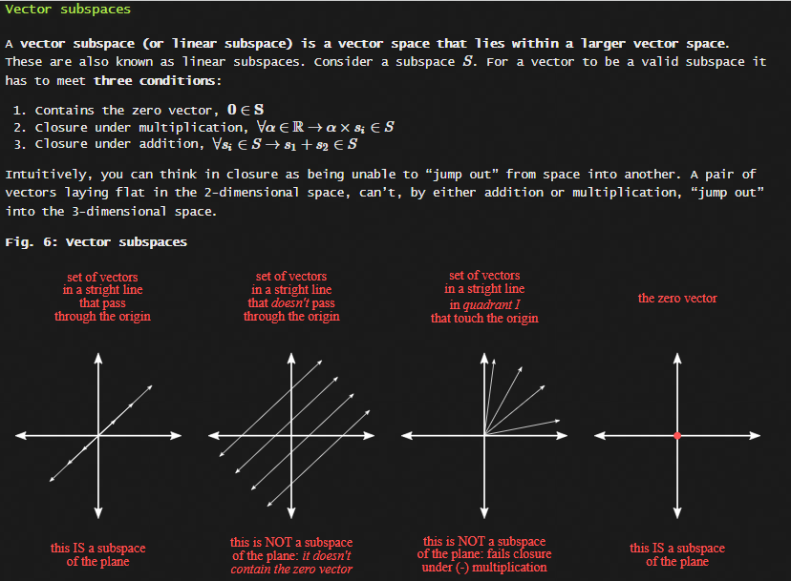

Slide 23
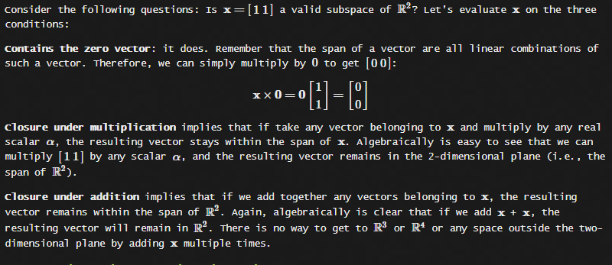

Slide 24
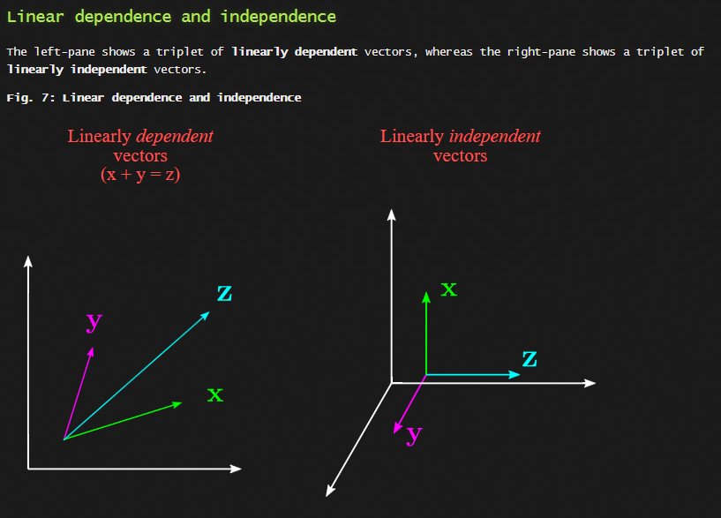

Slide 25
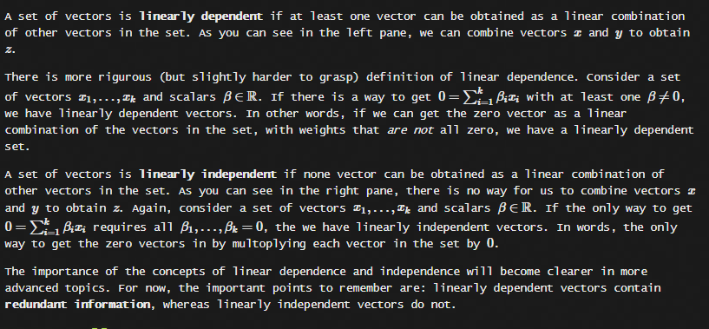

Slide 26
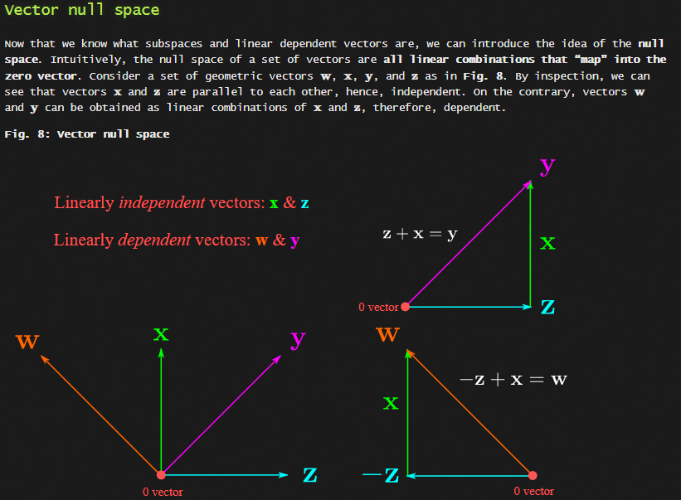

Slide 27
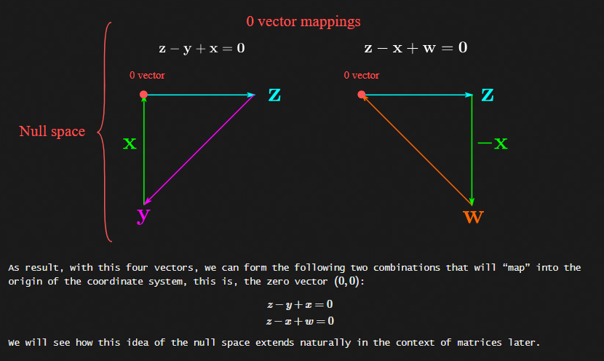

Slide 28
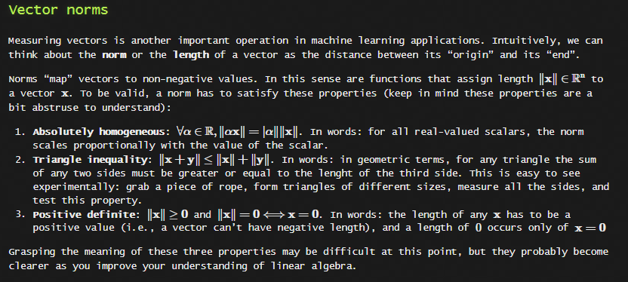

Slide 29
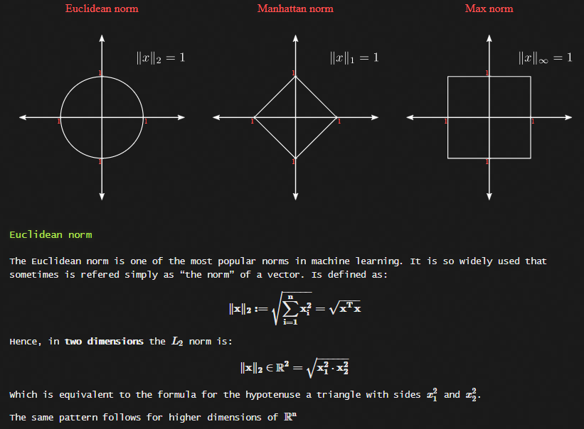

Slide 30
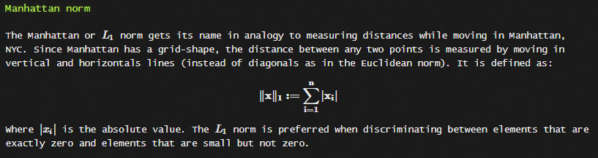
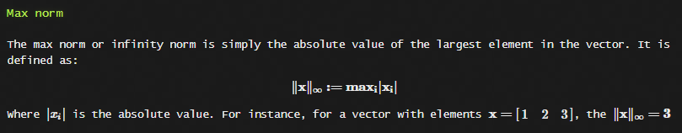

Slide 31
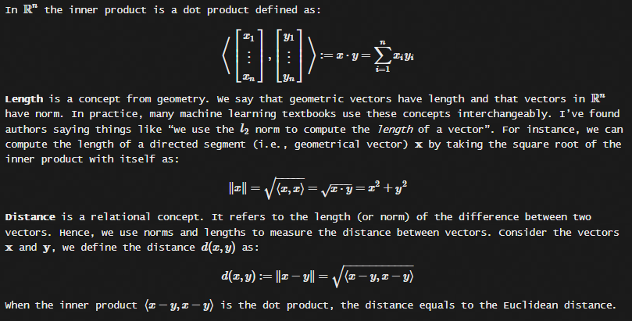
Vector inner product, length, and distance.
For practical purposes, inner product and length are used as equivalent to dot product and norm, although technically are not the same.
Inner products are a more general concept that dot products, with a series of additional properties. In other words, every dot product is an inner product, but not every inner product is a dot product. The notation for the inner product is usually a pair of angle brackets as ⟨.,.⟩⟨.,.⟩ as. For instance, the scalar inner product is defined as:
⟨x,y⟩:=x⋅y

Slide 32
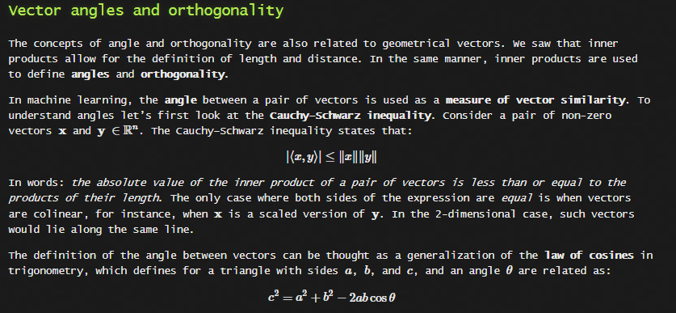

Slide 33
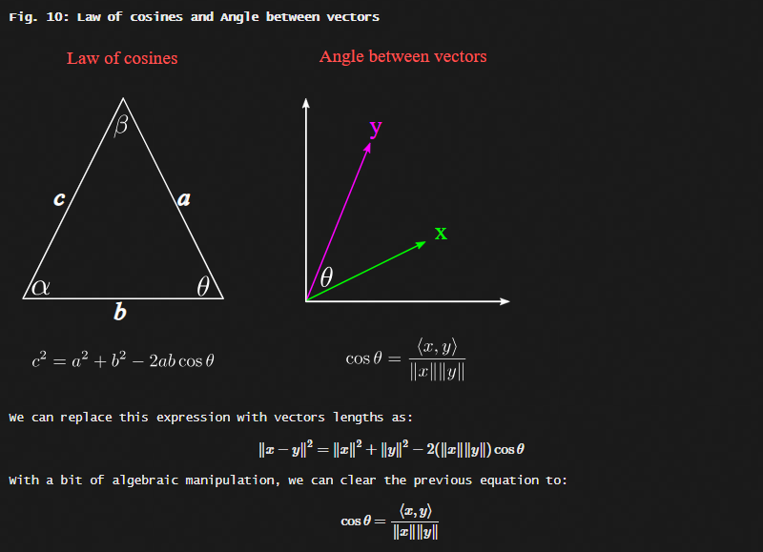

Slide 34
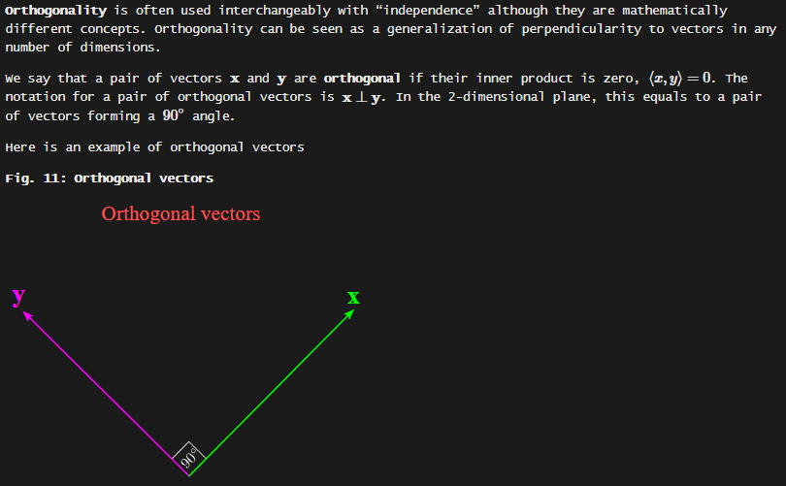

Slide 35
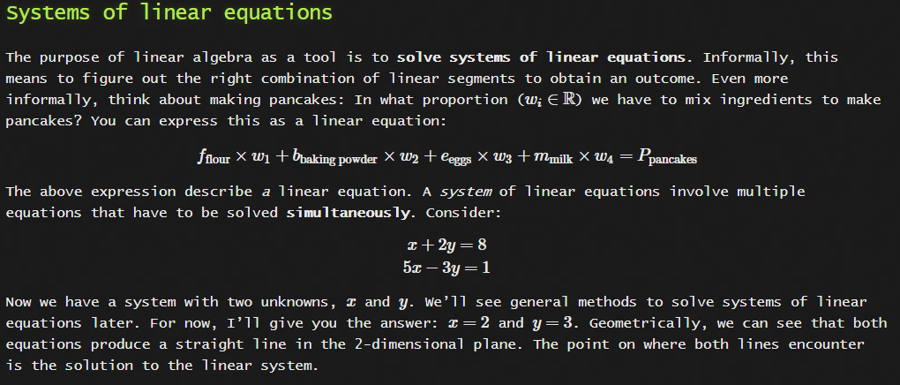

Slide 36
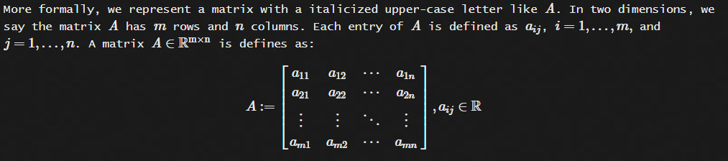
Matrices
Matrices are as fundamental as vectors in machine learning. With vectors, we can represent single variables as sets of numbers or instances. With matrices, we can represent sets of variables. In this sense, a matrix is simply an ordered collection of vectors. Conventionally, column vectors, but it’s always wise to pay attention to the authors’ notation when reading matrices. Since computer screens operate in two dimensions, matrices are the way in which we interact with data in practice.

Slide 37
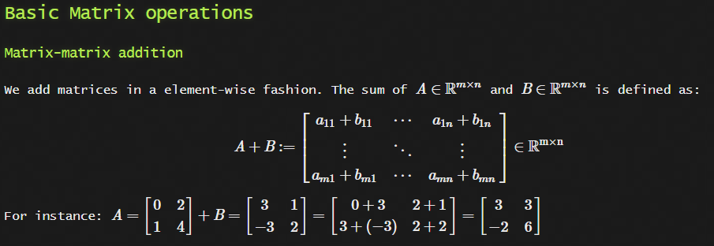
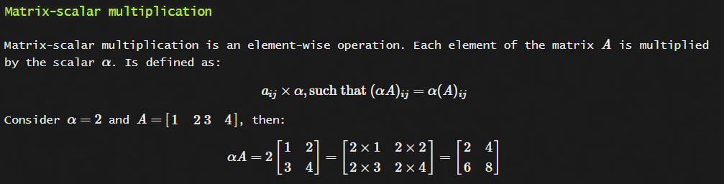

Slide 38
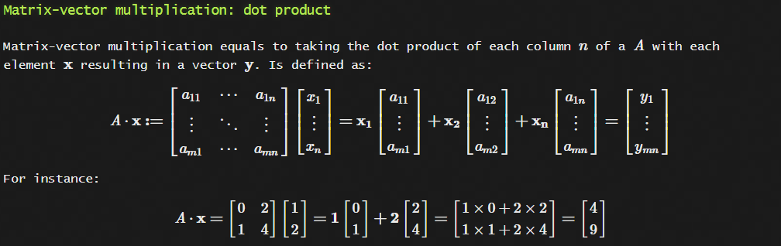
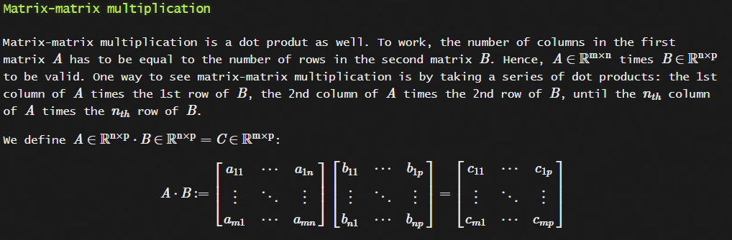

Slide 39
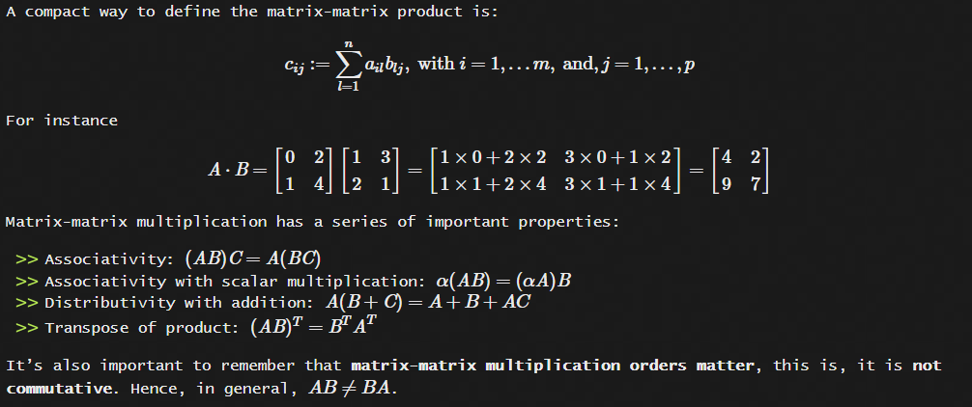

Slide 40
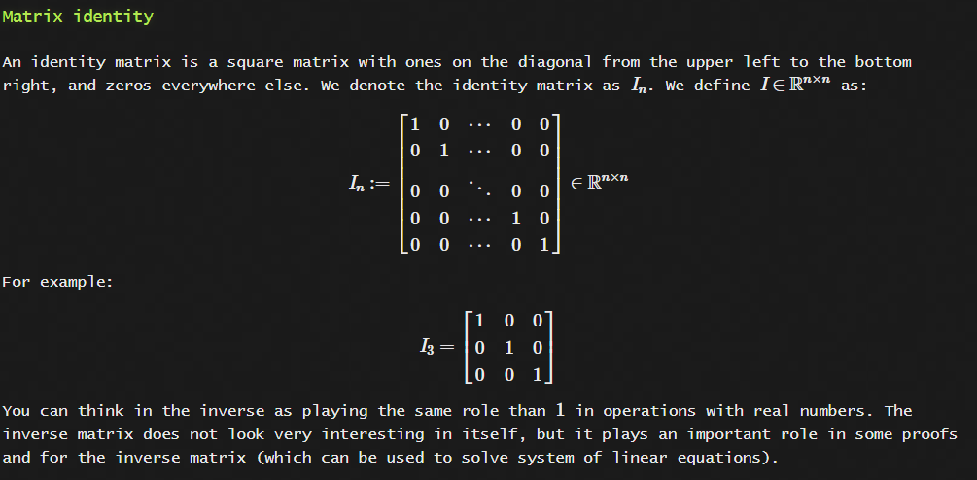

Slide 41
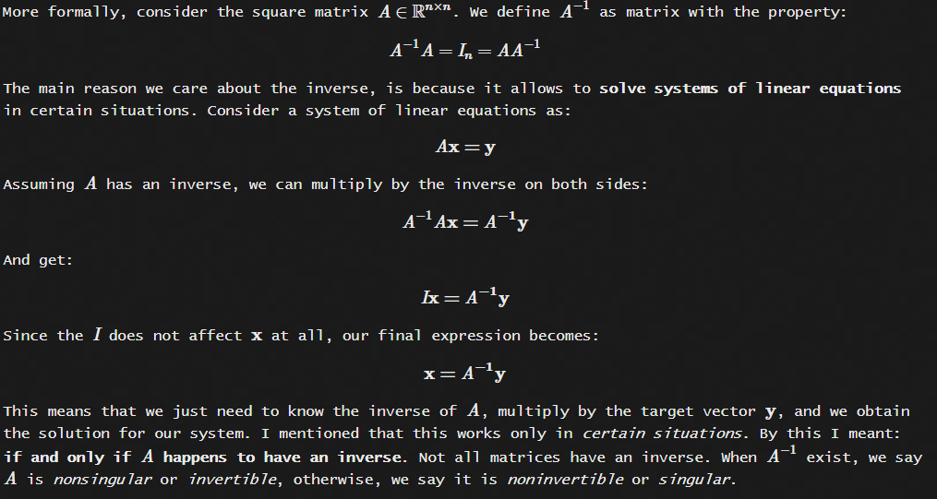
Matrix inverse

Slide 42
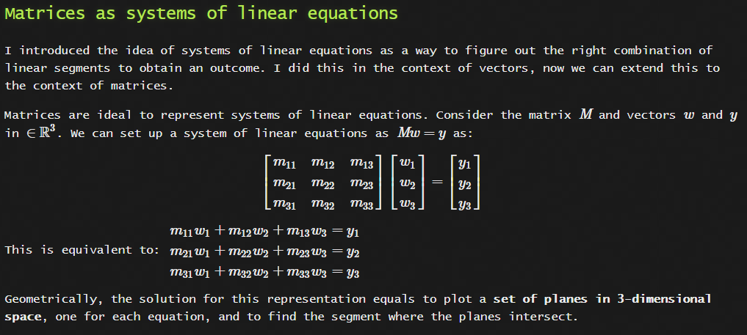

Slide 43
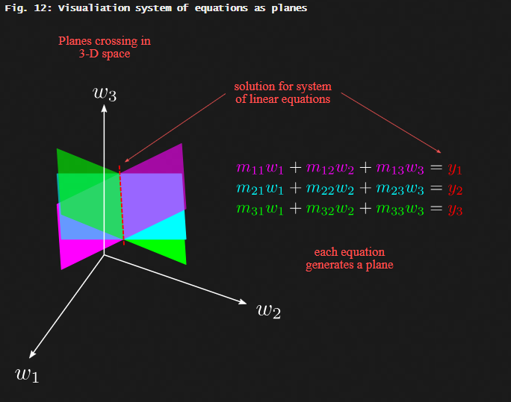

Slide 44
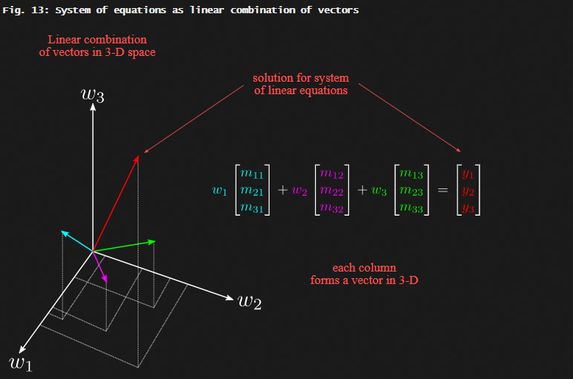

Slide 45
Solving systems of linear equations with Matrices
As systems of equations get larger and more complicated, such inspection-based methods become impractical. By inspection-based, I mean “just by looking at the equations and using common sense”. Thus, to approach such kind of systems we can use the method of Gaussian Elimination.
Gaussian Elimination, is a robust algorithm to solve linear systems. We say is robust, because it works in general, it all possible circumstances. It works by eliminating terms from a system of equations, such that it is simplified to the point where we obtain the row echelon form of the matrix. A matrix is in row echelon form when all rows contain zeros at the bottom left of the matrix. For instance:

Slide 46
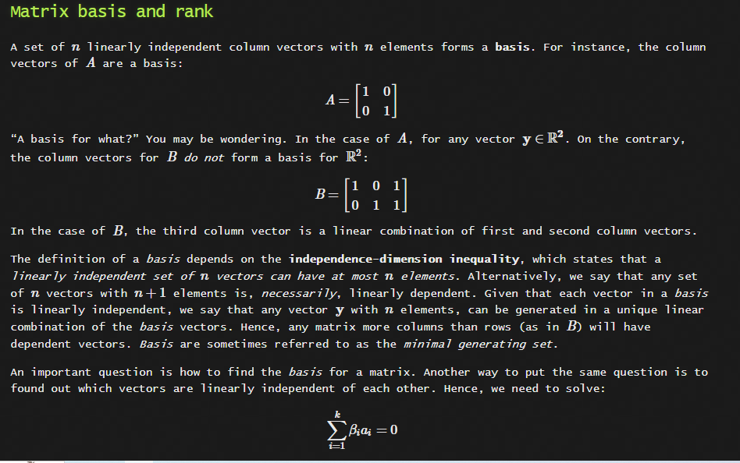

Slide 47
Part 1: Matrix Arithmetic
(w/applications to neural networks)

Slide 48
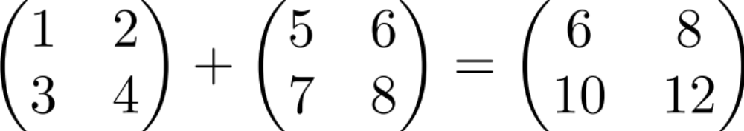
Matrix addition

Slide 49

Scalar times vector

Slide 50

Scalar times vector

Slide 51
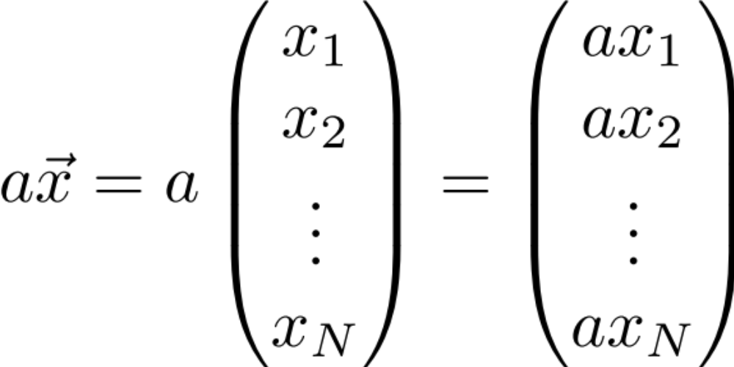
Scalar times vector

Slide 52
Product of 2 Vectors
Three ways to multiply
Element-by-element
Inner product
Outer product

Slide 53
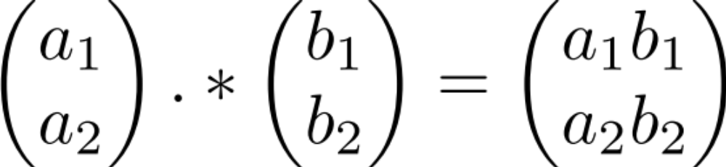
Element-by-element product (Hadamard product)
Element-wise multiplication (.* in MATLAB)

Slide 54
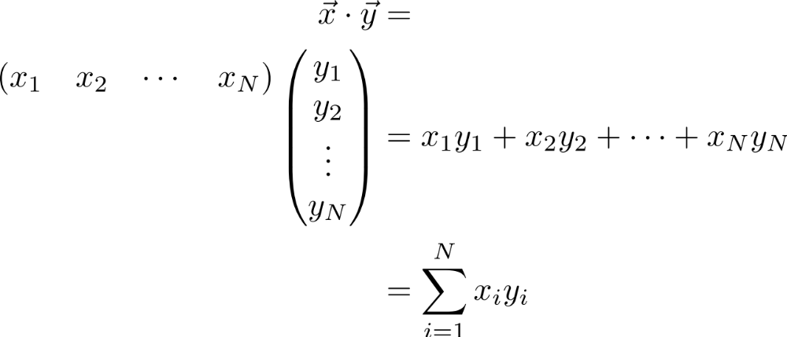
Multiplication:
Dot product (inner product)

Slide 55
Multiplication:
Dot product (inner product)

Slide 56
Multiplication:
Dot product (inner product)

Slide 57
Multiplication:
Dot product (inner product)

Slide 58
Multiplication:
Dot product (inner product)
1 X N
N X 1
1 X 1
MATLAB: ‘inner matrix dimensions must agree’
Outer dimensions give
size of resulting matrix

Slide 59



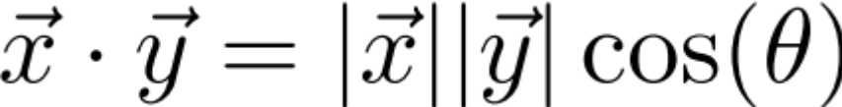
Dot product geometric intuition:
“Overlap” of 2 vectors

Slide 60
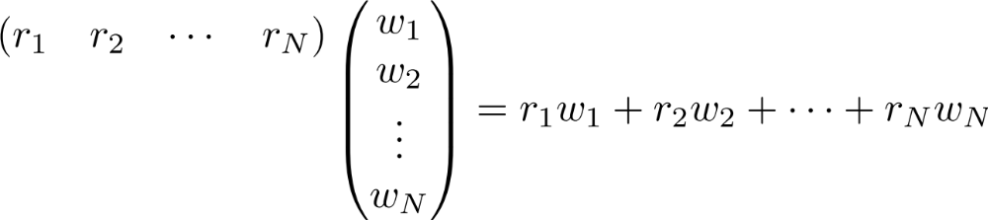
Example: linear feed-forward network
Input neurons’
Firing rates
r₁
r₂
r_{i}
r_{n}

Slide 61
Example: linear feed-forward network
Input neurons’
Firing rates
r₁
Synaptic weights
r₂
r_{i}
r_{n}

Slide 62
Example: linear feed-forward network
Input neurons’
Firing rates
r₁
Synaptic weights
r₂
Output neuron’s
firing rate
r_{i}
r_{n}

Slide 63



Example: linear feed-forward network
Input neurons’
Firing rates
Insight: for a given input (L2) magnitude, the response is maximized when the input is parallel to the weight vector
Receptive fields also can be thought of this way
r₁
Synaptic weights
r₂
Output neuron’s
firing rate
r_{i}
r_{n}

Slide 64
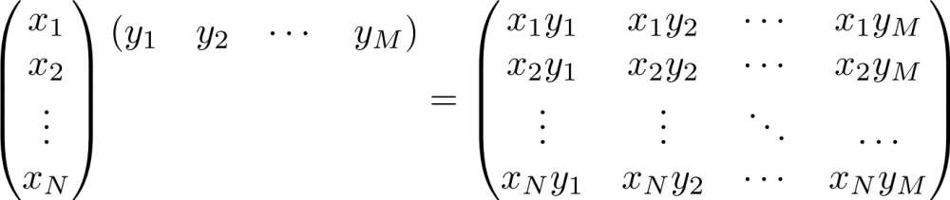
Multiplication: Outer product
N X 1
1 X M
N X M

Slide 65
Multiplication: Outer product

Slide 66
Multiplication: Outer product

Slide 67
Multiplication: Outer product

Slide 68
Multiplication: Outer product

Slide 69
Multiplication: Outer product

Slide 70

Multiplication: Outer product

Slide 71
Multiplication: Outer product
Note: each column or each row is a multiple of the others
Notes:
We’ll see implications of this feature shortly… (motivation for “rank 1”/1-dimensional matrix) and also underlying components of SVD

Slide 72
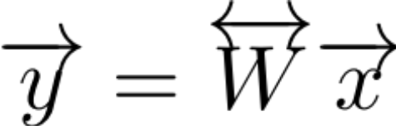
Matrix times a vector

Slide 73

Matrix times a vector

Slide 74
Matrix times a vector
M X 1
M X N
N X 1

Slide 75

Matrix times a vector:
inner product interpretation
Rule: the i^{th} element of y is the dot product of the i^{th} row of W with x

Slide 76
Matrix times a vector:
inner product interpretation
Rule: the i^{th} element of y is the dot product of the i^{th} row of W with x

Slide 77
Matrix times a vector:
inner product interpretation
Rule: the i^{th} element of y is the dot product of the i^{th} row of W with x

Slide 78
Matrix times a vector:
inner product interpretation
Rule: the i^{th} element of y is the dot product of the i^{th} row of W with x

Slide 79
Matrix times a vector:
inner product interpretation
Rule: the i^{th} element of y is the dot product of the i^{th} row of W with x

Slide 80


Matrix times a vector:
outer product interpretation
The product is a weighted sum of the columns of W, weighted by the entries of x

Slide 81
Matrix times a vector:
outer product interpretation
The product is a weighted sum of the columns of W, weighted by the entries of x

Slide 82
Matrix times a vector:
outer product interpretation
The product is a weighted sum of the columns of W, weighted by the entries of x

Slide 83
Matrix times a vector:
outer product interpretation
The product is a weighted sum of the columns of W, weighted by the entries of x

Slide 84


Example of the outer product method

Slide 85
Example of the outer product method
(0,2)
(3,1)

Slide 86
Example of the outer product method
(0,4)
(3,1)

Slide 87
Example of the outer product method
(3,5)
Note: different combinations of the columns of M can give you any vector in the plane
(we say the columns of M
“span” the plane)

Slide 88
Rank of a Matrix
Are there special matrices whose columns don’t span the full plane?

Slide 89

Rank of a Matrix
Are there special matrices whose columns don’t span the full plane?
(1,2)
(-2, -4)
You can only get vectors along the (1,2) direction (i.e. outputs live in 1 dimension, so we call the matrix rank 1)
Notes:
Such rank 1 matrices can be written as an outer product, e.g. in this case as (1 2)’ * (1 -2)

Slide 90



Example: 2-layer linear network
W_{ij} is the connection strength (weight) onto neuron y_{i} from neuron x_{j}.

Slide 91


Example: 2-layer linear network:
inner product point of view
What is the response of cell y_{i} of the second layer?
The response is the dot product of the i^{th} row of W with the vector x

Slide 92

Example: 2-layer linear network:
outer product point of view
How does cell x_{j} contribute to the pattern of firing of layer 2?
1st column
of W
Contribution
of x_{j} to
network output

Slide 93

Product of 2 Matrices
N X P
P X M
N X M
MATLAB: ‘inner matrix dimensions must agree’
Note: Matrix multiplication doesn’t (generally) commute, AB ≠ BA

Slide 94

Matrix times Matrix:
by inner products
C_{ij} is the inner product of the i^{th} row with the j^{th} column

Slide 95
Matrix times Matrix:
by inner products
C_{ij} is the inner product of the i^{th} row with the j^{th} column

Slide 96
Matrix times Matrix:
by inner products
C_{ij} is the inner product of the i^{th} row with the j^{th} column

Slide 97

Matrix times Matrix:
by inner products
C_{ij} is the inner product of the i^{th} row of A with the j^{th} column of B

Slide 98

Matrix times Matrix:
by outer products

Slide 99
Matrix times Matrix:
by outer products

Slide 100
Matrix times Matrix:
by outer products

Slide 101
Matrix times Matrix:
by outer products
C is a sum of outer products of the columns of A with the rows of B
Notes:
Note: this way of matrix multiplying, i.e. breaking into outer products is key to Singular Value Decomposition (SVD) which I’ll discuss at end of lecture; note that each outer product is rank 1 since each column (or row) is a multiple of every other column (or row)

Slide 102
Part 2: Matrix Properties
(A few) special matrices
Matrix transformations & the determinant
Matrices & systems of algebraic equations

Slide 103


Special matrices: diagonal matrix
This acts like scalar multiplication

Slide 104


Special matrices: identity matrix
for all

Slide 105

Special matrices: inverse matrix
Does the inverse always exist?
Notes:
For scalars, there is no inverse if the scalar’s value is 0. For matrices, the corresponding quantity that has to be nonzero for the inverse to exist is called the determinant, which we’ll show next corresponds geometrically (up to a sign) to an area (or, in higher dimensions, volume).

Slide 106
How does a matrix transform a square?
(0,1)
(1,0)

Slide 107

How does a matrix transform a square?
(0,1)
(1,0)

Slide 108
How does a matrix transform a square?
(0,2)
(0,1)
(3,1)
(1,0)
Notes:
Note, potentially a bit confusing: the vector (1,0) got mapped into (0,2) and (0,1) got mapped into (3,1): this relates to fact that determinant is negative (i.e. in some sense, orientation of parallelogram flipped)

Slide 109

Geometric definition of the determinant: How does a matrix transform a square?
(0,1)
(1,0)

Slide 110

Example: solve the algebraic equation

Slide 111
Example: solve the algebraic equation

Slide 112
Example: solve the algebraic equation
⇒
Notes:
If above determinant is zero, then inverse doesn’t exist and can’t conclude that x=0 by simply multiplying both sides of the equation by the inverse.

Slide 113

Example of an underdetermined system
Some non-zero vectors are sent to 0

Slide 114
Example of an underdetermined system
Some non-zero vectors are sent to 0

Slide 115
Example of an underdetermined system
⇒

Slide 116
Example of an underdetermined system
⇒
Some non-zero x are sent to 0 (the set of all x with Mx=0 are called the “nullspace” of M)
This is because det(M)=0 so M is not invertible. (If det(M) isn’t 0, the only solution is x = 0)
Notes:
c

Slide 117
Part 3: Eigenvectors & eigenvalues

Slide 118
What do matrices do to vectors?
(0,2)
(2,1)
(3,1)

Slide 119
Recall
(3,5)
(2,1)

Slide 120
What do matrices do to vectors?
(3,5)
The new vector is:
1) rotated
2) scaled
(2,1)

